Slide 1
An Illustrative Example of a Management Procedure for Eastern North Atlantic Bluefin Tuna
.
Rebecca Rademeyer and Doug Butterworth
NB: This is intended purely as an example
.
To illustrate the MP concept in an NABFT context
To highlight key data and management issues for the Eastern NABFT population

Slide 2
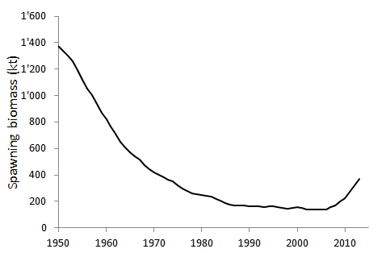
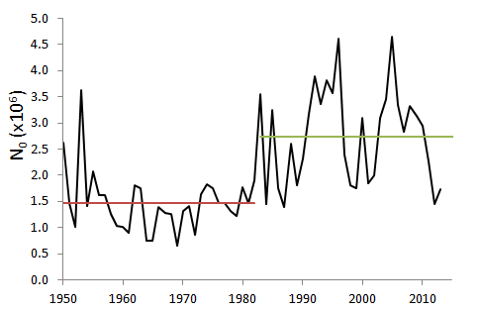
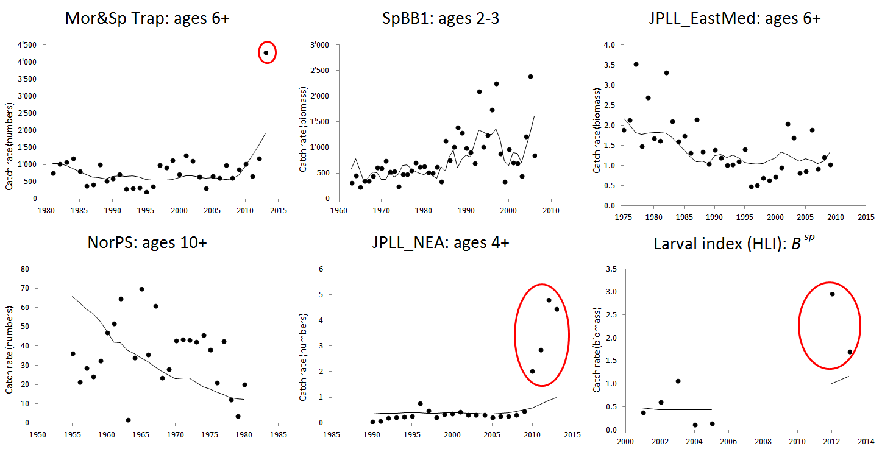
Eastern bluefin tuna: Reference Case
Problems:
Periods of
low and high
recruitment
Doesn’t fit recent high data

Slide 3
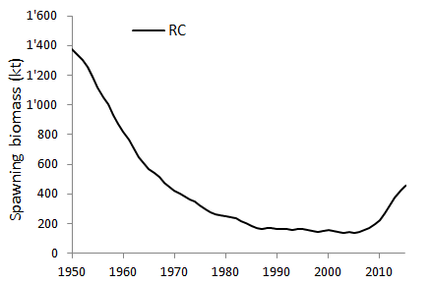
Eastern bluefin tuna: Four OMs
Four OMs (alternative assessments):
RC

Slide 4
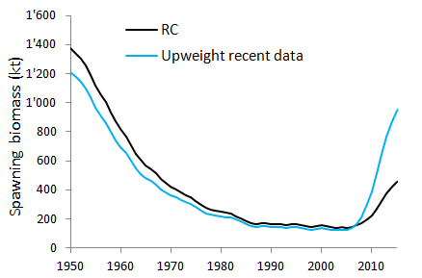
Eastern bluefin tuna: Four OMs
Four OMs (alternative assessments):
RC
S1: Upweight recent data (5x for 2010+ for JLL and larval indices)

Slide 5
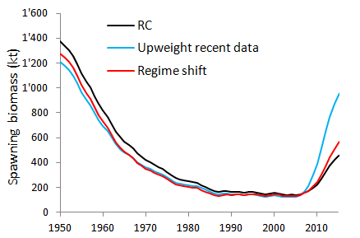
Eastern bluefin tuna: Four OMs
Four OMs (alternative assessments):
RC
S1: Upweight recent data (5x for 2010+ for JLL and larval indices)
S2a: Regime shift (1983), continue with high recruitment in the future
S2b: Same as S2a; change is in the future (go back to low recruitment in 2020)

Slide 6
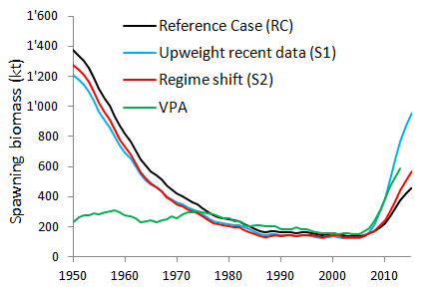
Eastern bluefin tuna: Four OMs
Four OMs (alternative assessments):
RC
S1: Upweight recent data (5x for 2010+ for JLL and larval indices)
S2a: Regime shift (1983), continue with high recruitment in the future
S2b: Same as S2a; change is in the future (go back to low recruitment in 2020)

Slide 7
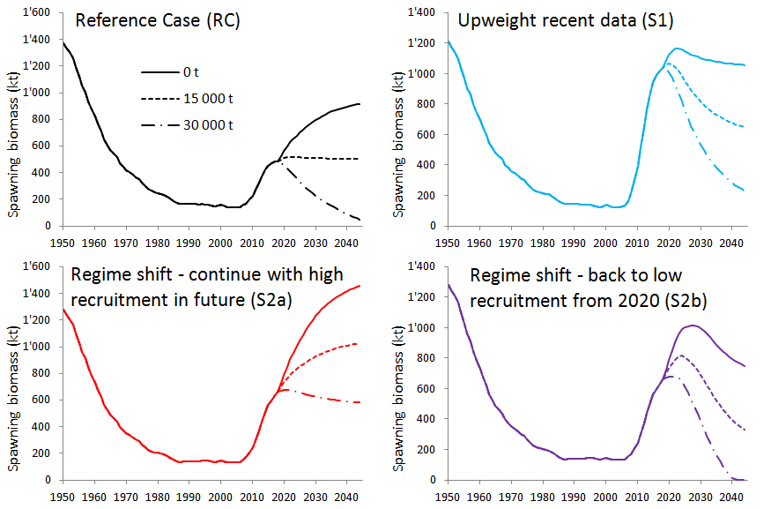
Eastern bluefin tuna: Four OMs
Constant catch projections (0, 15000t and 30 000t), deterministic
Catch taken to be: 13 500t, 16 142t, 19 296t and 23 155t for 2014 to 2017

Slide 8
Eastern bluefin tuna:
Candidate Management Procedure (CMP)
Depends on average slope of indices (last 10 years data)
Depends on average level of indices relative to a target (last 5 years data)
λ and ρ are tuning parameters, then can take on different values whether the slope (or level) (here λ_{up}=0.03, λ_{down}=0.15, ρ_{up}=0.03 and ρ_{down}=0.15)
Indices used: Japan Longline CPUE, larval index of spawning biomass
Can include constraint on maximum interannual change in TAC (here +-15%)
Can include cap on TAC (here: no cap, cap of 30 000t and cap of 40 000t)
The target level for abundance J_{targ} is set here to 50% of the average for S2a and S2b in the absence of catches

Slide 9
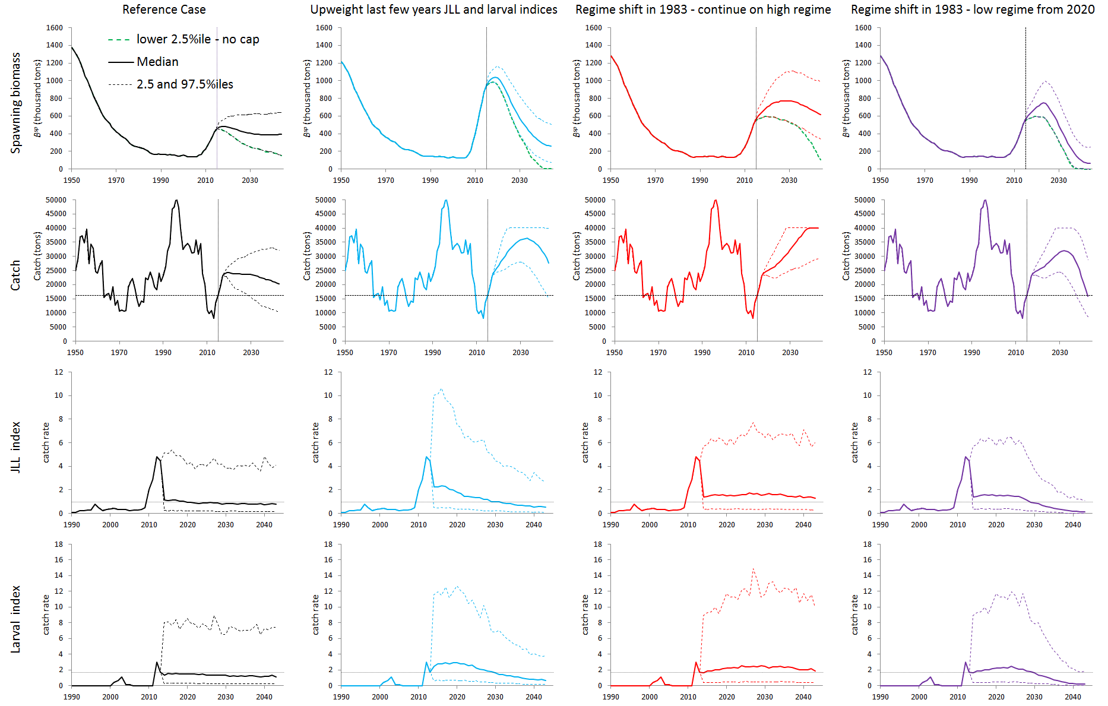
Eastern bluefin tuna:
Stochastic projections under CMP1 with 40 000t cap
CV=0.78
CV=0.77
CV=0.72
CV=0.72
CV=0.87
CV=0.75
CV=0.83
CV=0.83

Slide 10
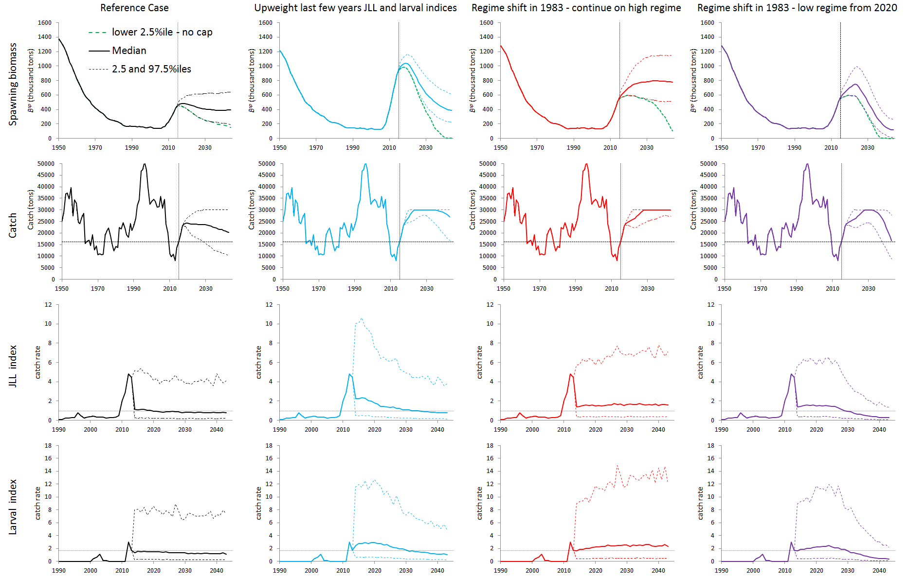
Eastern bluefin tuna:
Stochastic projections under CMP1 with 30 000t cap
CV=0.78
CV=0.77
CV=0.72
CV=0.72
CV=0.87
CV=0.75
CV=0.83
CV=0.83

Slide 11
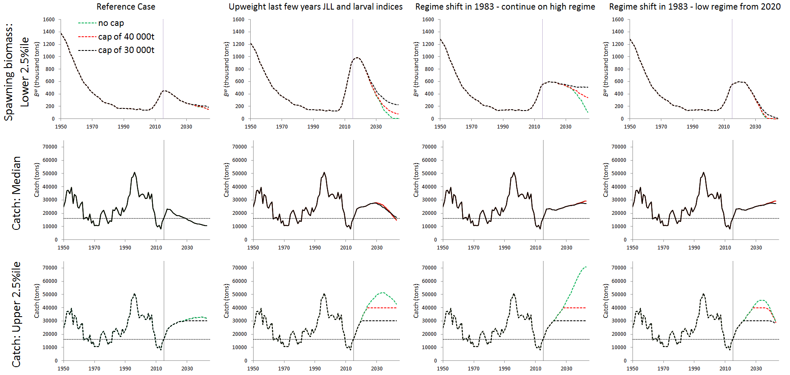
Eastern bluefin tuna:
Comparison of CMP1 with no cap, cap of 30 000t and cap of 40 000t

Slide 12
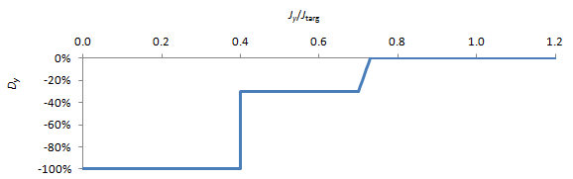
Eastern bluefin tuna:
CMP2: Additional decrease if indices fall below specified level

Slide 13
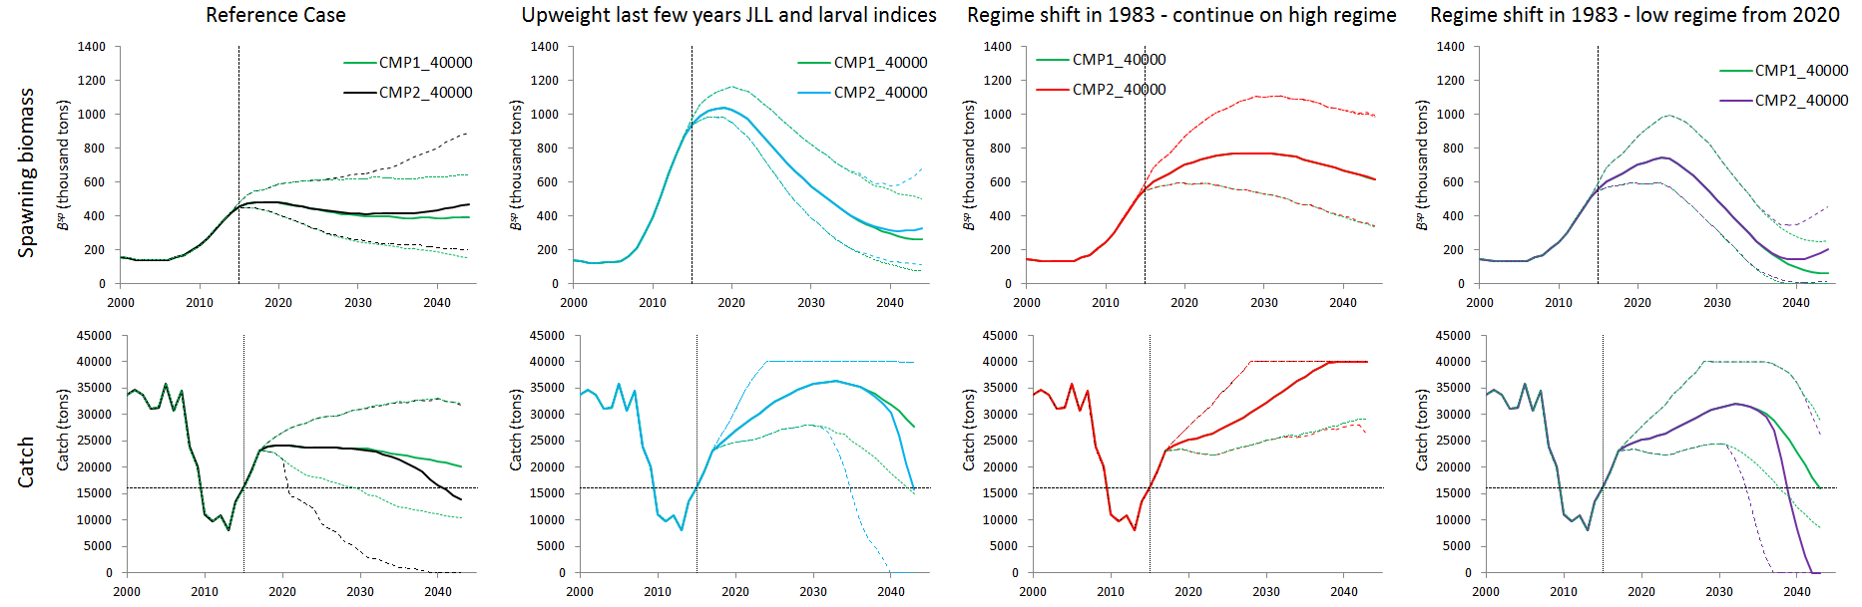
Eastern bluefin tuna:
Comparison of CMP1 and CMP2 (extra decrease), both with 40 000t cap

Slide 14

Eastern bluefin tuna:
Comparison of CMP1 and CMP2 (extra decrease), both with 30 000t cap

Slide 15
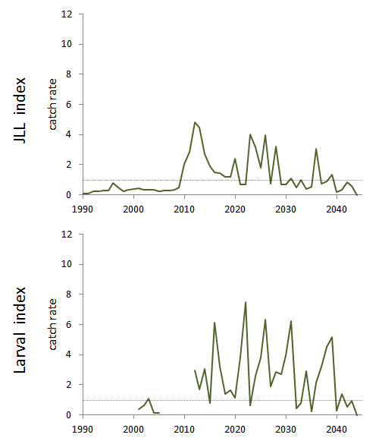
Eastern bluefin tuna:
Indices projections for S2b – note how noisy

Slide 16
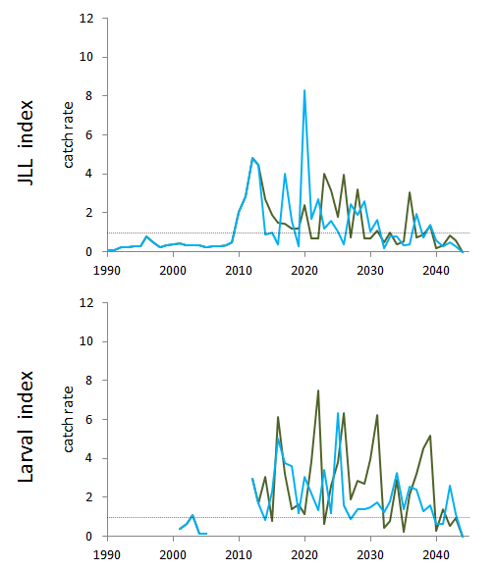
Eastern bluefin tuna:
Indices projections for S2b – note how noisy

Slide 17
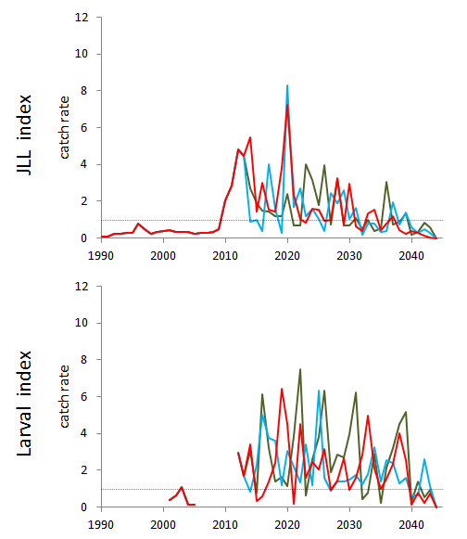
Eastern bluefin tuna:
Indices projections for S2b – note how noisy

Slide 18
What’s to note and to do?
In taking ICCAT bluefin MP process further, carefully consider:
a) What indices to use for MP input
b) The error structure for those indices
c) Possible future recruitment scenarios and their plausibilities
Consider potential for improvement by adding further indices – e.g. for recruitment (as for SBT)
NB: This is intended only as an EXAMPLE; it is for ILLUSTRATIVE purposes only!!

Slide 19
MPs for Bluefin – Where next?
1) Data for conditioning operating models
2) Data series to serve as MP inputs
a) Selection
b) Specification of error structure
3) Specification of future recruitment scenarios
4) Agreement of process to accept conditioning as satisfactory for baseline trials
5) Specification of full set of robustness trials
6) Conditioning of trials
7) Is the first step:
a) An ocean wide single MP covering both west and east spawning populations, or
b) Separate MPs based on single stock assessments (operating models) for west and east, with a mixing model used for a robustness test?

